Slide 1
1. PERT Problems, Ch. 7, T1
2. Scheduling Res & Costs, Ch. 8, T1
M K Hamirwasia
WILPD

Slide 2
AE ZG523/DE ZG523/ES ZG523/MM ZG523/POM ZG523-Merged
Project Management
Lecture No. 09

Slide 3
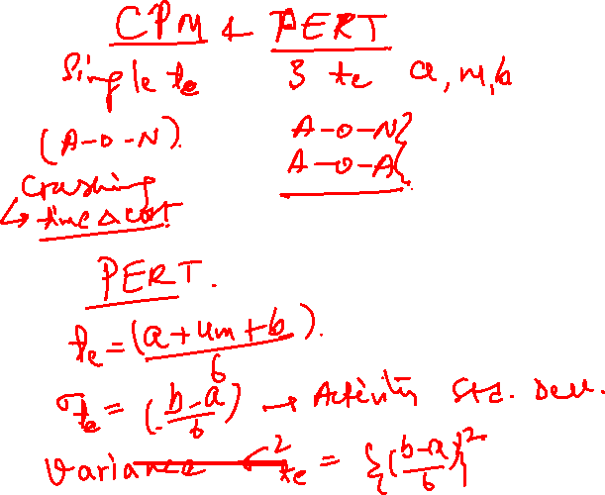

Slide 4
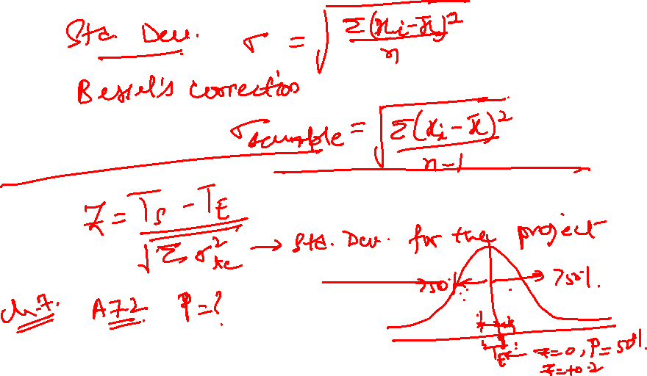

Slide 5
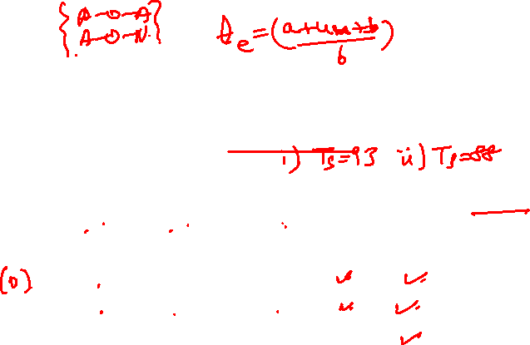
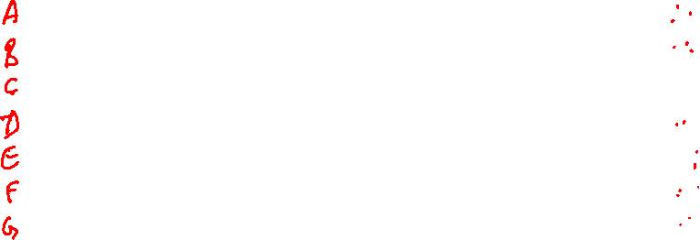
Exercise 1
Given the project information below, what is the probability of completing the National Holiday Toy project in (i) 93 time units? (ii) in 88 time units?
Act ID(i) | Description | Predecessor | Optm. (a) | Most likely (m) | Pess. (b) | Act. Time (t_{e}) | Variance {(b-a)/6}² | Critical
1 | Design Package | None | 6 | 12 | 24 | 13 | 9 | Y
2 | Design product | 1 | 16 | 19 | 28 | 20 | 4 | Y
3 | Build package | 1 | 4 | 7 | 10 | 7 | 1 | N
4 | Secure patent | 2 | 21 | 30 | 39 | 30 | 9 | Y
5 | Build product | 2 | 17 | 29 | 47 | 30 | 25 | Y
6 | Paint | 3, 4,5 | 4 | 7 | 10 | 7 | 1 | N, Y, Y
7 | Test market | 6 | 13 | 16 | 19 | 16 | 1 | Y

Slide 6
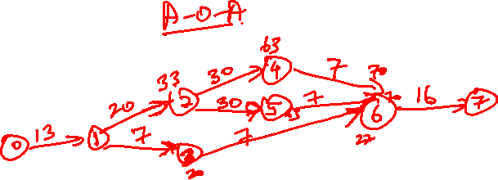
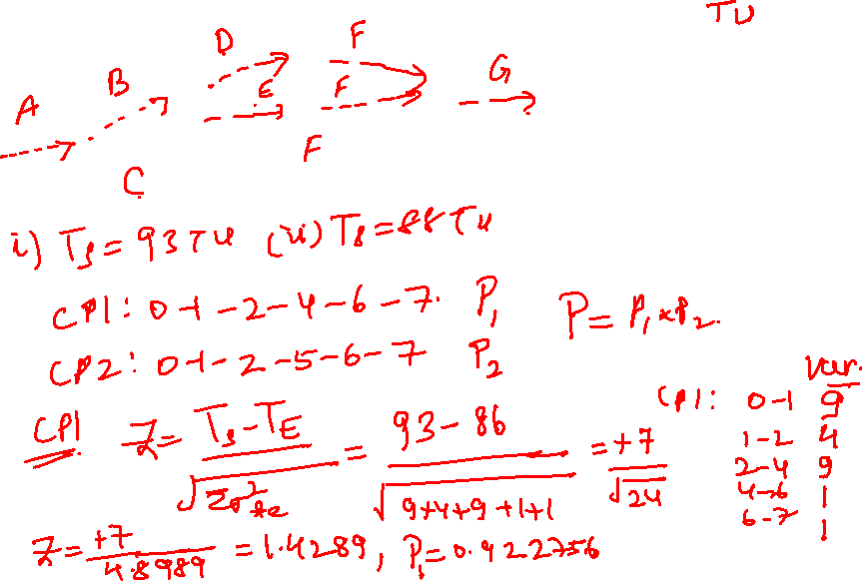


Slide 7
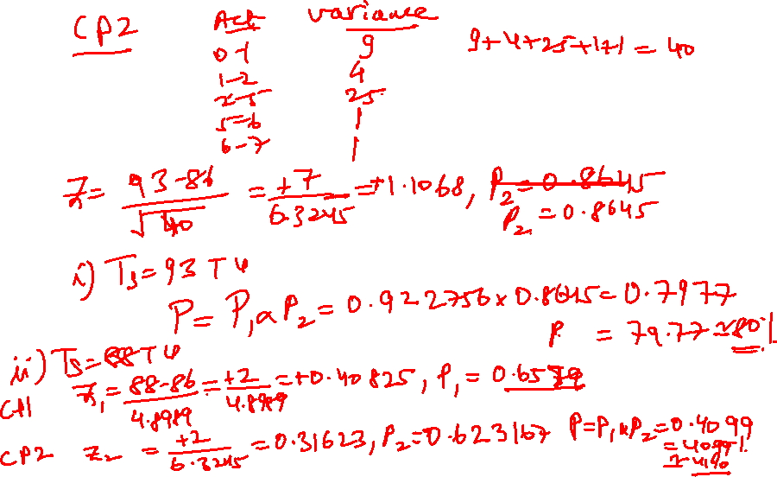

Slide 8
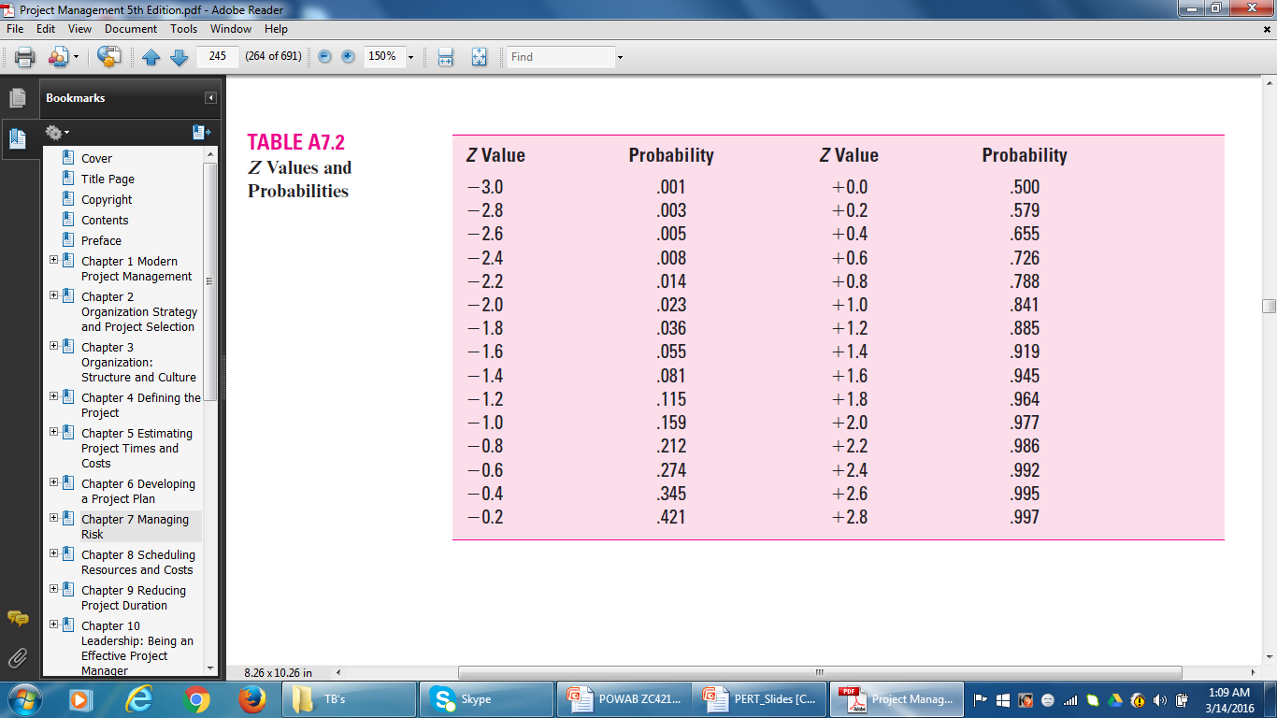
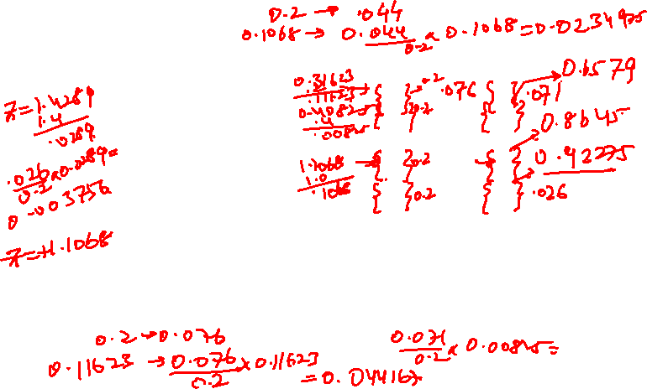
Z Values and Probabilities

Slide 9
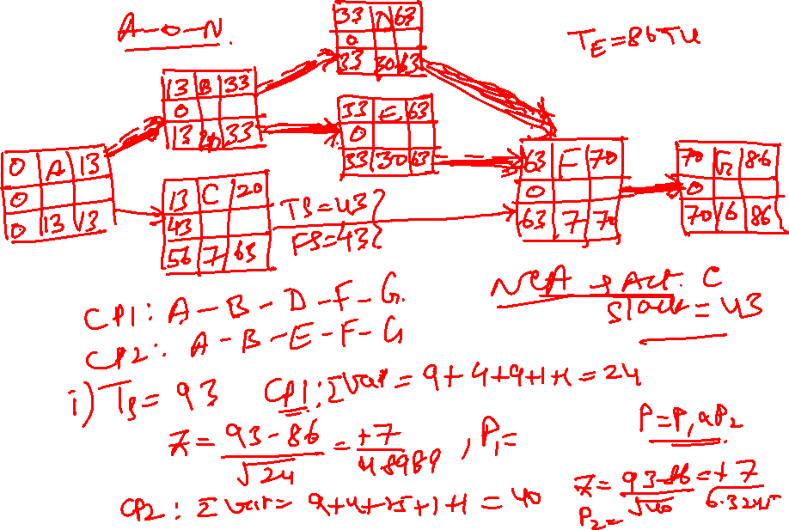

Slide 10
Exercise 1 (A-O-A)
CP₁: 0-1-2-4-6-7 (86)
CP₂: 0-1-2-5-6-7 (86)
4
T_{E1} = 86 Weeks
30
7
T_{E2} = 86
13
20
30
0
1
7
16
2
5
6
7
7
7
3
T_{E3} = 43

Slide 11
A-O-N
Act ID | Description | Predecessor | Optm. (a) | Most likely (m) | Pess. (b) | Act. Time (t_{e}) | Variance {(b-a)/6}² | Critical
A | Design Package | None | 6 | 12 | 24 | 13 | 9 | Y
B | Design product | A | 16 | 19 | 28 | 20 | 4 | Y
C | Build package | A | 4 | 7 | 10 | 7 | 1 | N
D | Secure patent | B | 21 | 30 | 39 | 30 | 9 | Y
E | Build product | B | 17 | 29 | 47 | 30 | 25 | Y
F | Paint | C, D, E | 4 | 7 | 10 | 7 | 1 | N, Y, Y
G | Test market | F | 13 | 16 | 19 | 16 | 1 | Y

Slide 12
Z Values and Probabilities

Slide 13
A-O-N
13 | B | 33
0 | DPR
13 | 20 |  | 33
33 | D | 63
0 | SP
33 | 30 |  | 63
0 | A | 13
0 | DPC
0 | 13 |  | 13
33 | E | 63
0 | BP
33 | 30 |  | 63
63 | F | 70
0 | PT
63 | 7 | 70
70 | G | 86
0 | TMKT
70 | 16 |  | 86
13 | C | 20
43 | BP
56 | 7 | 63
CP1: A-B-D-F-G
CP2: A-B-E-F-G
T_{E} = 86 Weeks

Slide 14
Exercise 1
CP₁: 0-1-2-4-6-7 (T_{E} = 86) A-O-A
CP1: A-B-D-F-G (T_{E} = 86) A-O-N
  σT_{E} = √ ∑ (σt_{e} )² = √9+4+9+1+1 = √ 24
  Z = TS – TE = 93 -86 = 1.428869
σ_{TE} √ 24
P = .92275 (92.28 percent)
Taking the scheduled completion time to be 88 weeks;
  Z = 88 - 86 = 2 = 0.408248, P = 0.6579
√ 24 4.899 (65.79 percent)

Slide 15
Exercise 1
CP₂: 0-1-2-5-6-7 (T_{E} = 86) A-O-A
CP₂: A-B-E-F-G (T_{E} = 86) A-O-N
  σT_{E} = √ ∑ (σt_{e} )² = √9+4+25+1+1 = √ 40
  Z = TS – TE = 93 -86 = 1.106797
σ_{TE} √ 40
P = .8645 (86.45 percent)
Taking the scheduled completion time to be 88 weeks;
  Z = 88 - 86 = 2 = 0.316228 P = 0.6232
√ 40 6.3245 (62.32 percent)

Slide 16
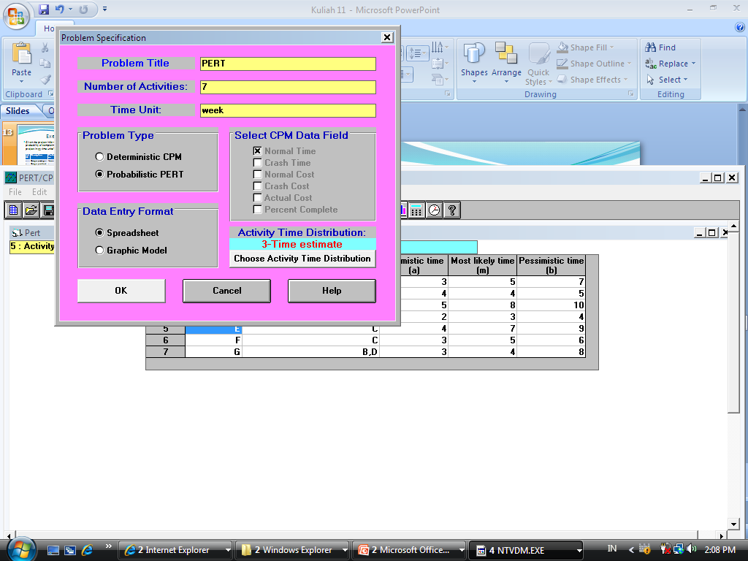
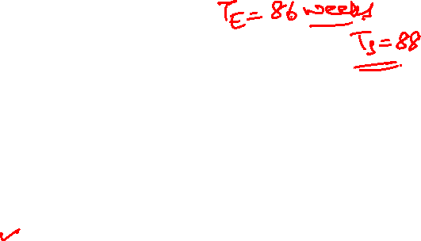
Solve Exercise 1 Using WIN QS

Slide 17
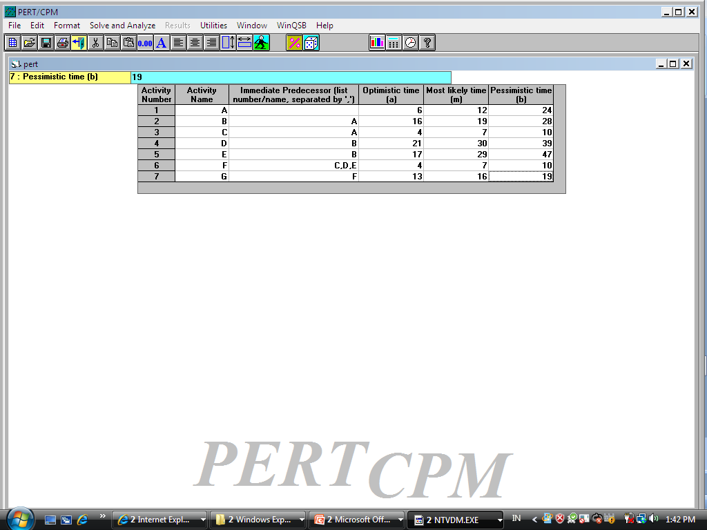
Input the data

Slide 18
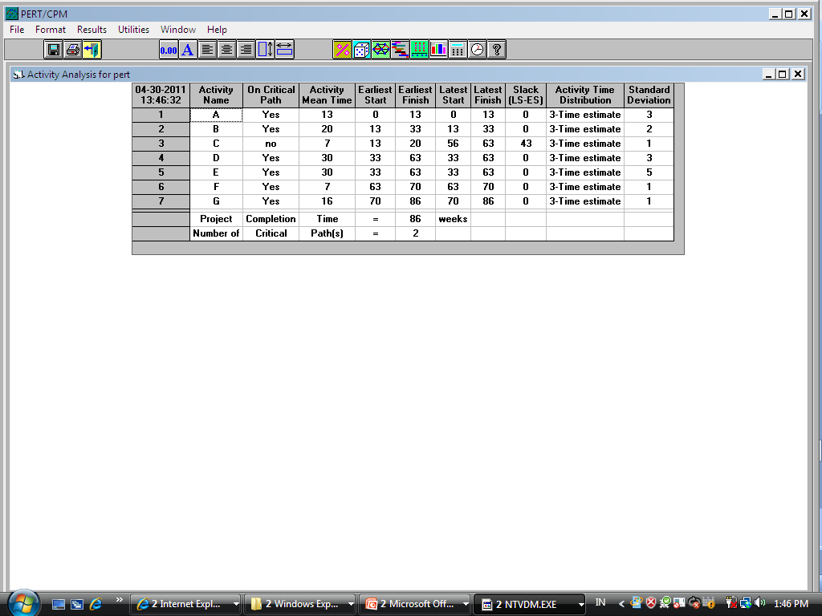
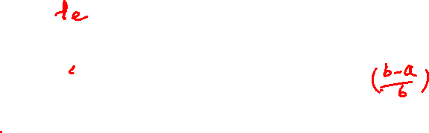
Solve and Analyse – Solve Critical Path

Slide 19
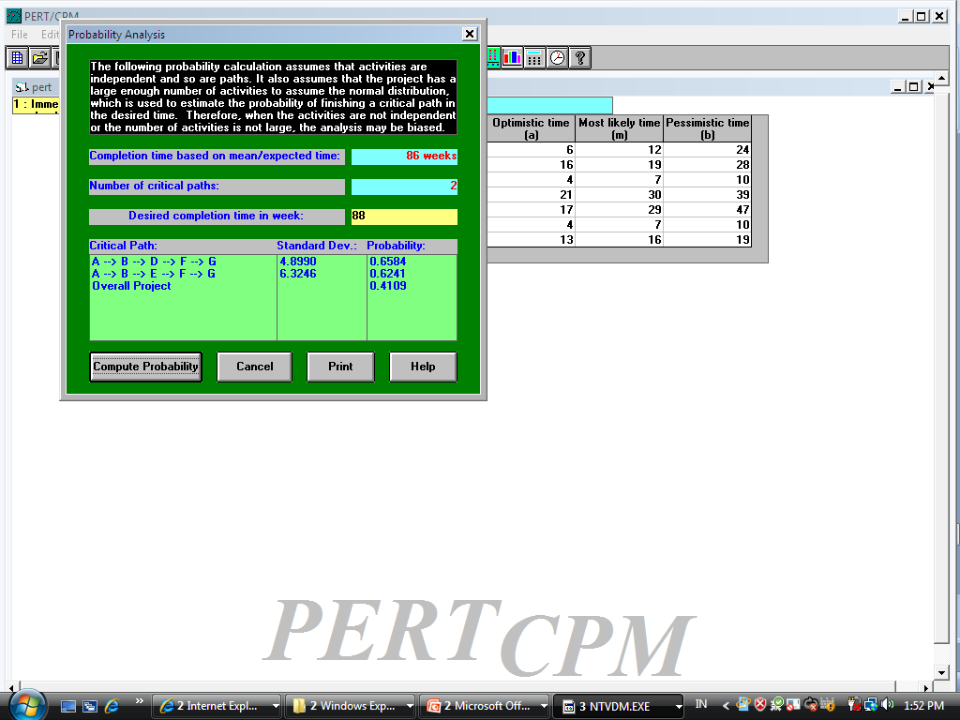
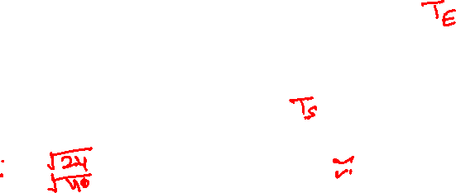
Results – Perform Probability Analysis

Slide 20
Exercise 2
The expected times and variances for the project activities are given below. What is the probability of completing the project in 25 periods?

Slide 21
Exercise 2

Slide 22
Z Values and Probabilities

Slide 23
A-O-N
6 | 4 | 10
0 | TM
6 | 4 | 10
10 | 6 | 26
0 | FP
10 | 16 |  | 26
0 | 1 | 6
0 | PP
0 | 6 | 6
6 | 5 | 16
10 | Patent
16 | 10 |  | 26
26 | 8 | 28
0 | Release
26 | 2 | 28
0 | 2 |  | 7
19 | SCD
19 | 7 | 26
4 | 7 | 7
19 | Ad Pr
23 | 3 | 26
0 | 3 |  | 4
19 | DMP
19 | 4 | 23
CP: 1-4-6-8
T_{E} = 28

Slide 24
A-O-N
  CP: 1-4-6-8
  σT_{E} = √ ∑ (σt_{e} )² = √3+2+10+1 = √ 16 = 4
  Z = TS – TE = 25 - 28 = - 0.75
σ_{TE} √16
P = 0.2275 (22.75 percent)

Slide 25
SCHEDULING RESOURCES and COSTS, Ch. 8, T1
M K Hamirwasia
WILPD

Slide 26
Scheduling Resources and Costs
Project networks are based on two premises:
The time estimates are based on the assumption that resources will be available as required.
The sequence of activities is based on technical / logical considerations.

Slide 27
The Resource Problem
Resources and Priorities
  Project network times are not a schedule until resources have been assigned.
  Cost estimates are not a budget until they have been time-phased.

Slide 28
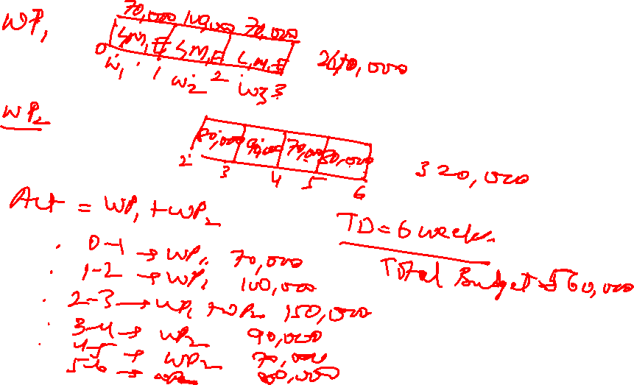

Slide 29
Scheduling Resources and Costs
First prepare the resource schedule (Direct costs of people, material and equipment).
Assign time-phased costs that provide the project budget baseline – PV.
Monitor progress by checking the schedule and cost variances – actual versus planned.

Slide 30
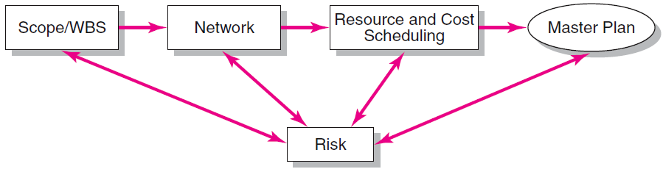
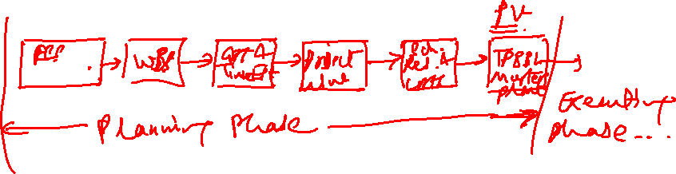
Project Planning Process

Slide 31
The Resource Problem (cont’d)
Resource Smoothing (or Leveling)
  Involves attempting to even out varying demands on resources by using slack (delaying noncritical activities) to manage resource utilization when resources are adequate over the life of the project.
Resource-Constrained Scheduling
  The duration of a project may be increased by delaying the late start of some of its activities if resources are not adequate to meet peak demands.

Slide 32
Project Management
Thank You!
M K Hamirwasia

